Slide 1

Virtualization & Containerization
From Hardware to Cloud Native
A deep dive into the technologies that power modern computing — from abstracting physical hardware to orchestrating cloud-native workloads at scale.

Slide 2

Defining Virtualization
Virtualization decouples resources from their physical providers, enabling multiple isolated environments to share a single host.
Abstraction
Isolation
Separates software from hardware, creating virtual versions of CPU, memory, storage, and networking.
Each virtual environment runs independently, with no interference between guests.
Consolidation
Multiple workloads share one physical host, reducing cost and complexity.

Slide 3
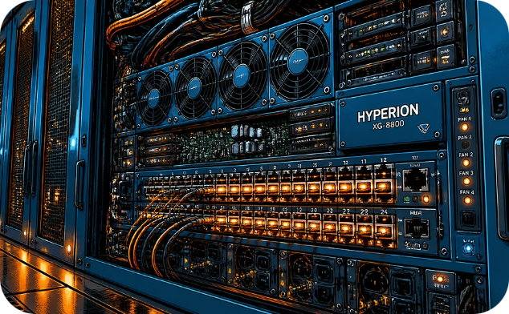
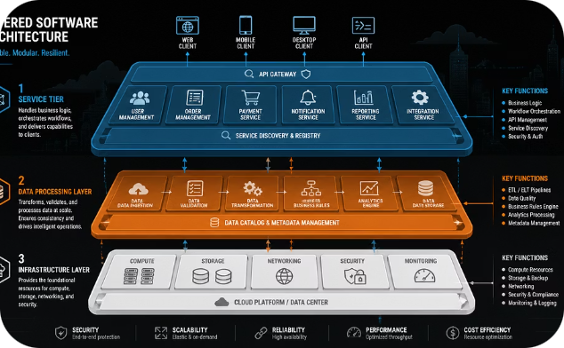
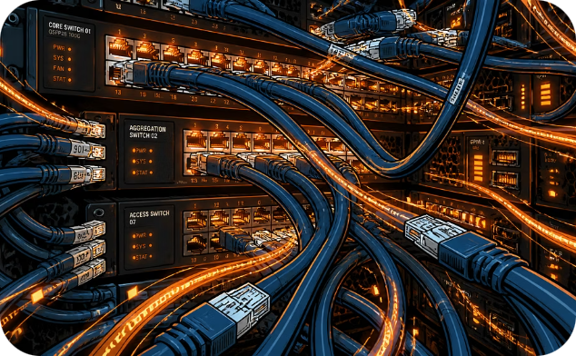
Types of Virtualization
Virtualization spans multiple layers of the stack — from hardware to applications.
Hardware Virtualization
OS-Level Virtualization
Application & Network
Emulates entire computer systems, enabling multiple OS instances on one machine.
Isolates processes on a shared kernel, forming the basis of containers.
Abstracts software or infrastructure layers for portability and flexibility.

Slide 4
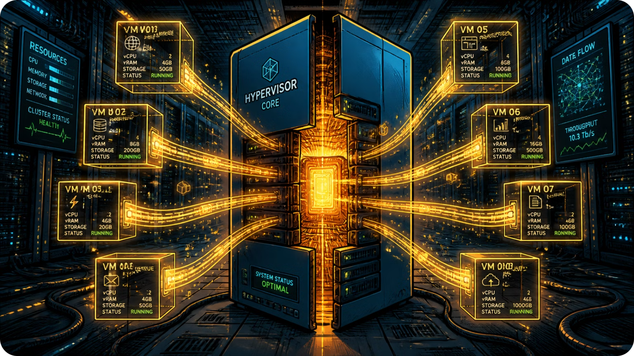

HARDWARE VIRTUALIZATION
One Machine, Many Worlds
Hardware virtualization transforms a single physical server into multiple isolated guest machines, each with its own kernel and operating system.
Server Consolidation
Multi-Platform Testing
Run dozens of workloads on fewer physical servers.
Test different OS configurations without dedicated hardware.

Slide 5
Full vs. Paravirtualization
Full Virtualization
Paravirtualization
The VMM (virtual machine monitor) presents an abstraction identical to physical hardware. Guest OS requires no modifications — it runs unmodified, unaware of the hypervisor.
The guest OS is modified to be hypervisor-aware, making explicit calls that reduce overhead and boost performance.
Complete hardware emulation
Higher overhead due to binary translation
Examples: VMware, QEMU
Guest OS modified for the hypervisor
Lower overhead, higher throughput
Examples: Xen (paravirt mode)

Slide 6


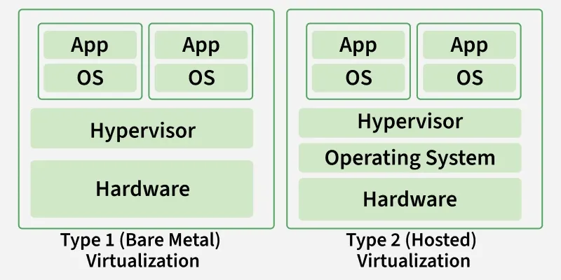
Hypervisors: The Virtual Machine Monitor
The hypervisor (VMM) sits between hardware and VMs, managing resource allocation, isolation, and lifecycle.
Type 1 — Bare-Metal
Type 2 — Hosted
Runs directly on hardware with no host OS. Ideal for production
Runs within a conventional host OS. Great for development.
Xen, VMware ESXi, Microsoft Hyper-V
VirtualBox, VMware Workstation

Slide 7
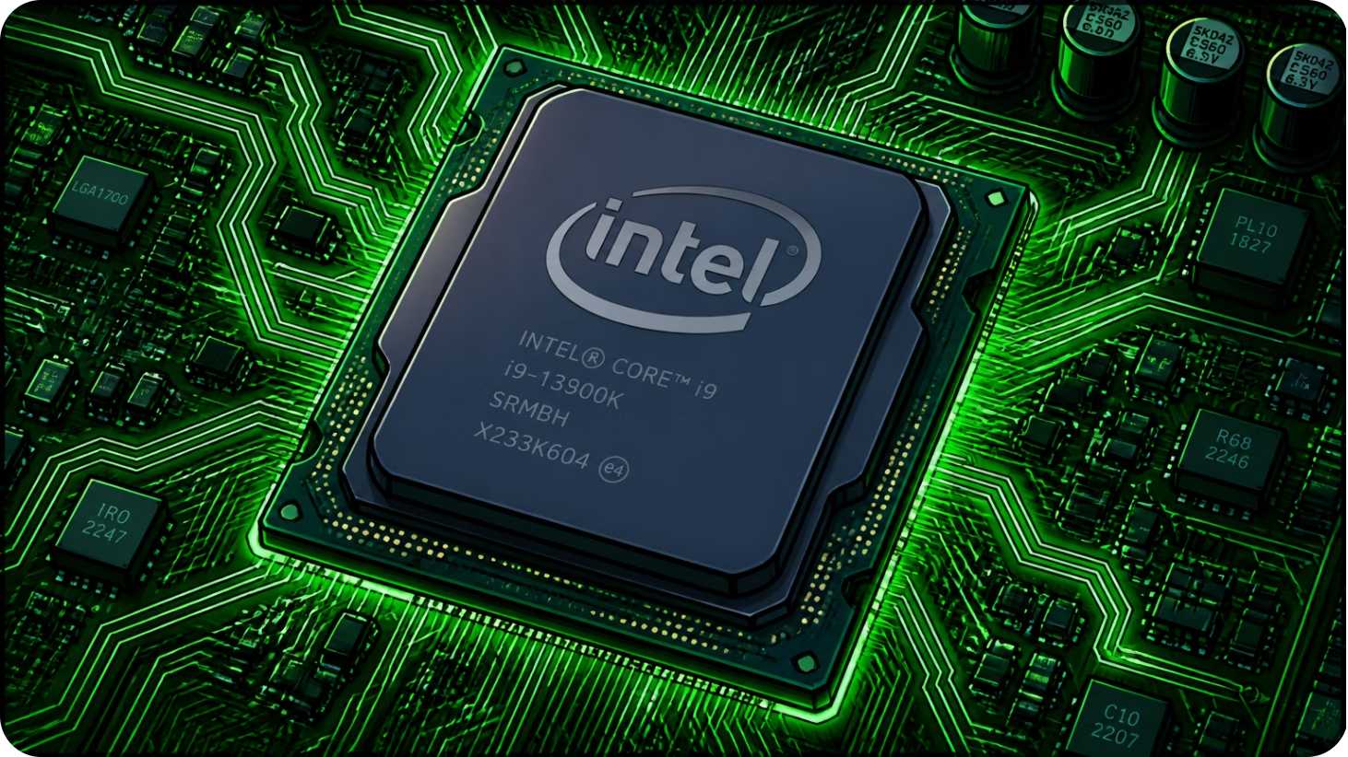

PERFORMANCE OPTIMIZATION
Hardware-Assisted Virtualization
Intel VT-x and AMD-V introduced CPU-level instructions to handle virtualization tasks in hardware, reducing hypervisor overhead.
Simplified Transitions
Reduced Binary Translation
Near-Native Performance
Hardware manages guest-to-host mode switches directly.
Privileged instructions execute natively, eliminating costly emulation.
VMs approach bare-metal speed for compute-intensive workloads.

Slide 8
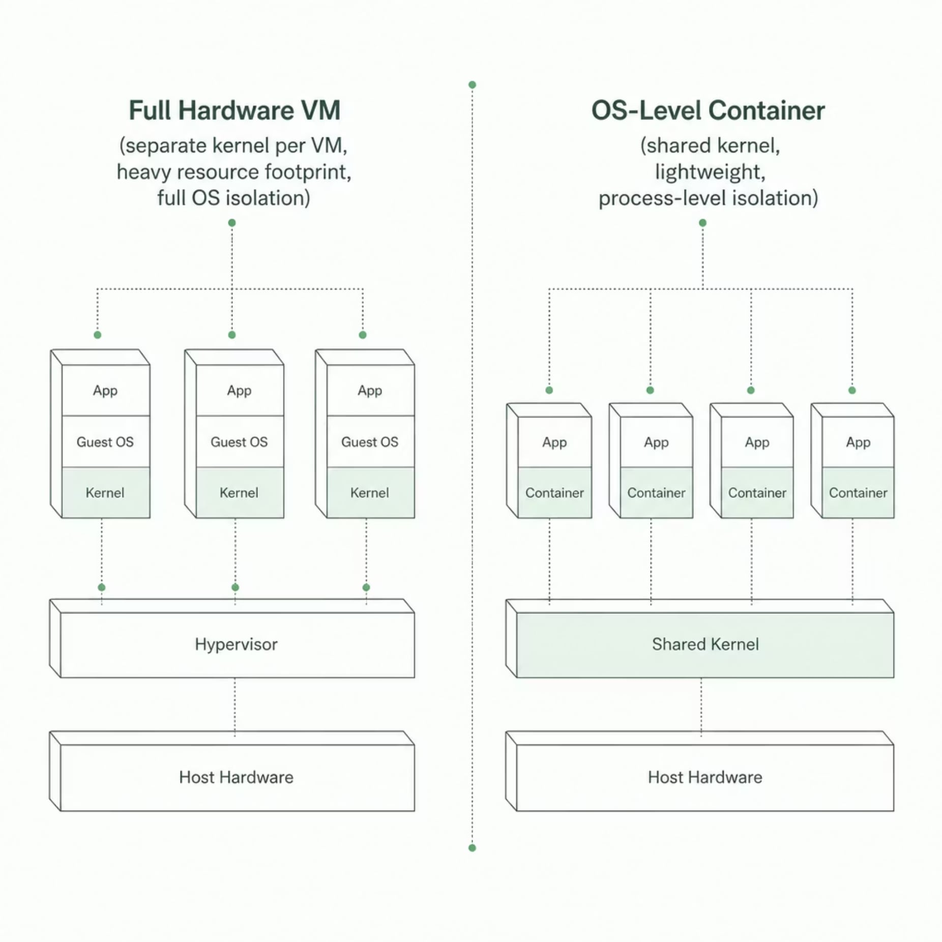
OS-Level Virtualization
Unlike hardware VMs, OS-level virtualization shares the host kernel across all instances — dramatically lighter and faster.
Why It Matters
Lightweight — No duplicate kernels; startup in seconds
Efficient — More instances per host than VMs
Isolated — Processes cannot interfere across containers
Containers are the foundation of modern cloud-native architectures.

Slide 9
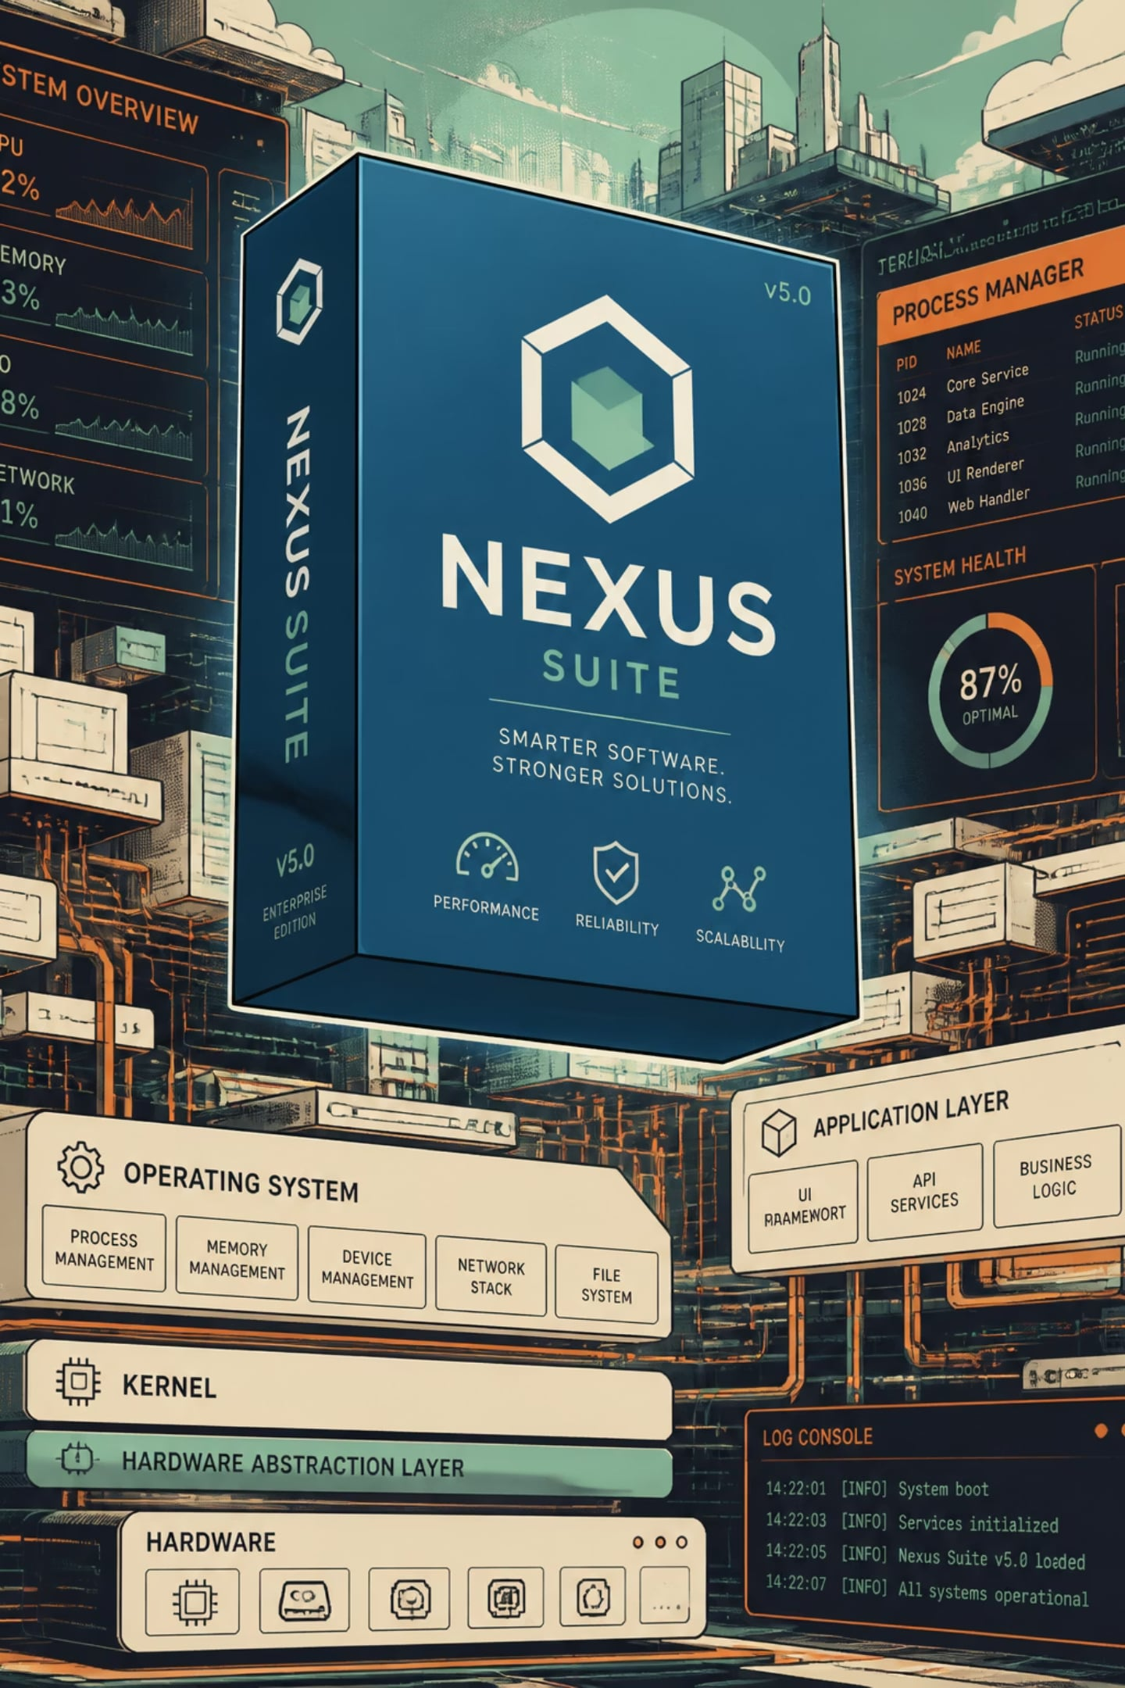


Application Virtualization
Application virtualization decouples software from the underlying OS, allowing apps to run in self-contained packages without installation dependencies.
1
2
No Installation Required
Portability
Apps run in isolated sandboxes without modifying the host OS.
Same package runs across different OS versions and environments.
3
Legacy Support
Run outdated software on modern systems without compatibility issues.

Slide 10
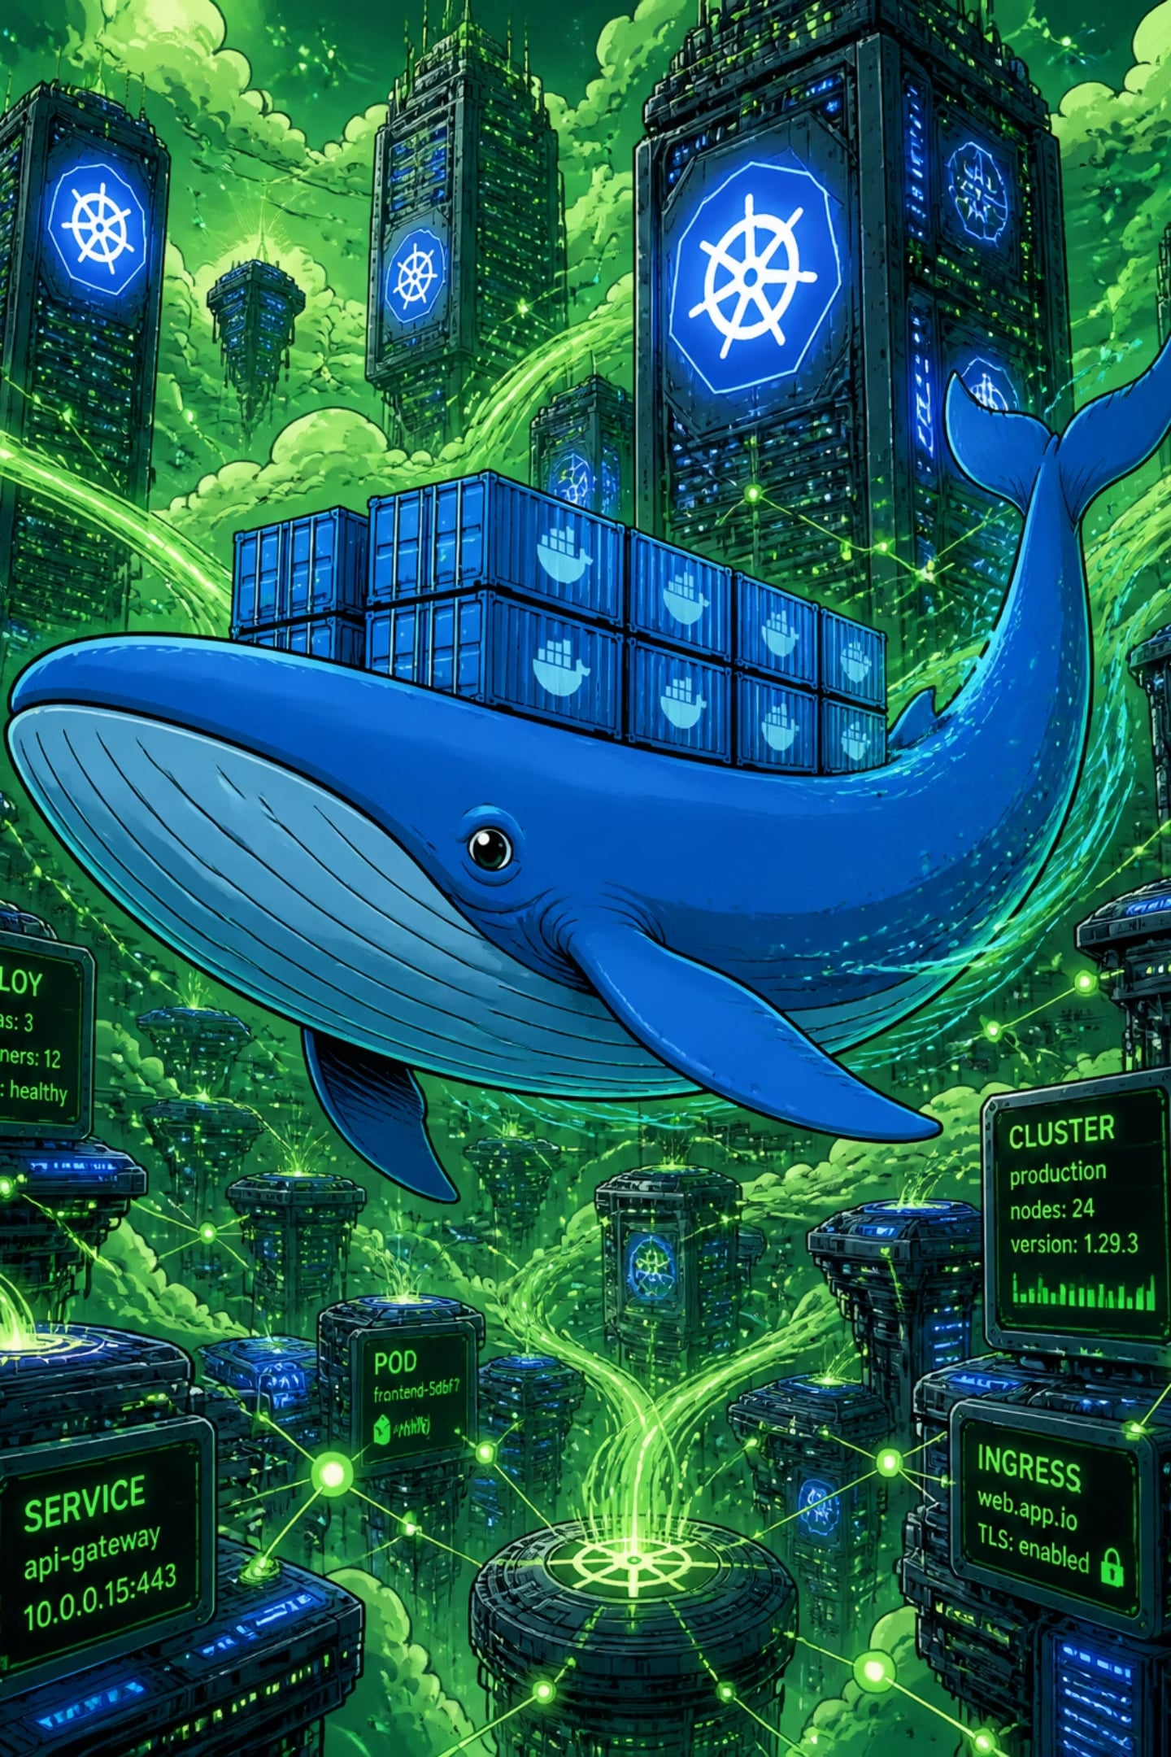



The Container Revolution
Docker and Kubernetes transformed how applications are built, shipped, and run at scale.
Docker
Kubernetes
Packages apps into immutable, portable images with all dependencies bundled.
Orchestrates containers across clusters — automating deployment, scaling, and healing.
Cloud Native Standard
The backbone of microservices architectures and modern DevOps pipelines.

